Slide 1
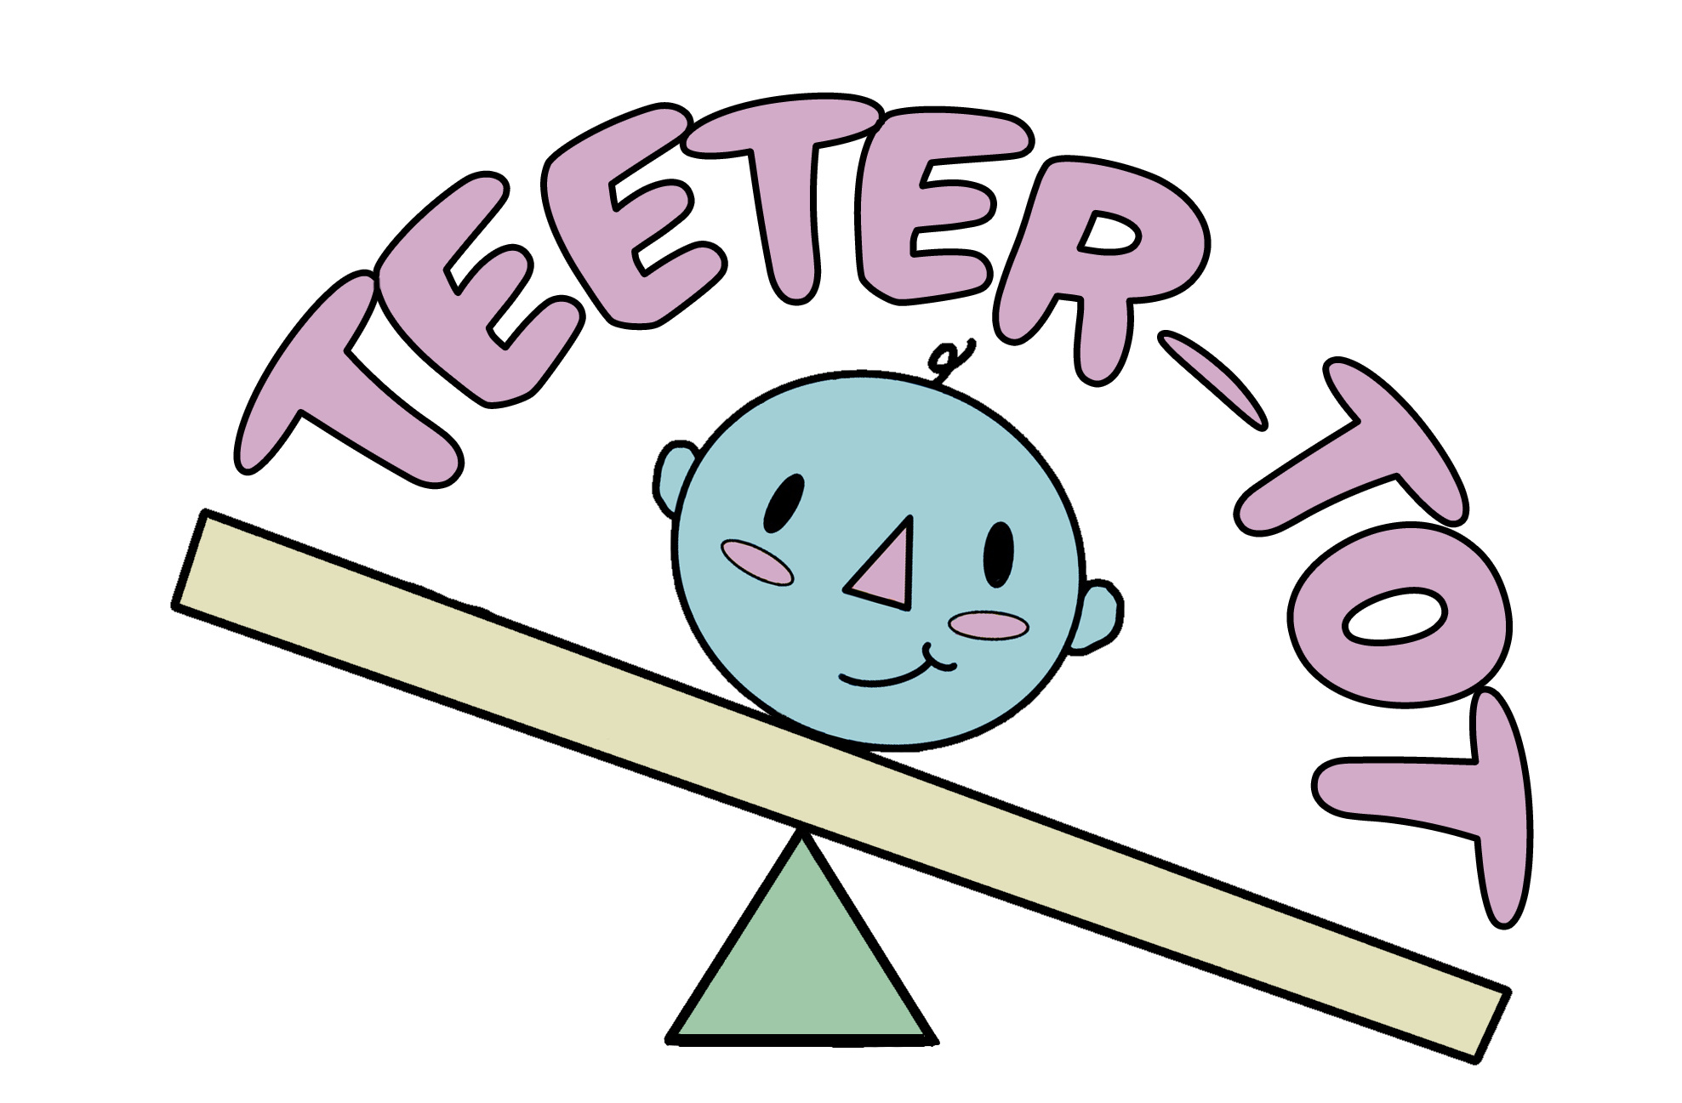
For Plagiocephaly Prevention
Notes:
[TERA]
Hi everyone, I’m Tera, …, and we have designed the Teeter-Tot, a medical device that prevents the development of plagiocephaly.

Slide 2
01
Clinical Need
Notes:
[TERA]
So what is the clinical need? How common is plagiocephaly?

Slide 3
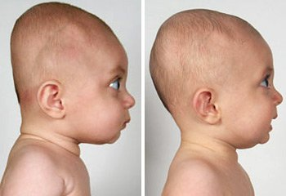
Medical Condition
Notes:
[TERA]
Flat head syndrome is common in 50% of newborns. Although there are different types of cranial deformities, the medical condition we are focusing on is positional plagiocephaly, which occurs after birth due to the infant lying in a prone position. This occurs because the infants’ heads are softest during their first four months, and flat head development is susceptible with a stationary head position.

Slide 4
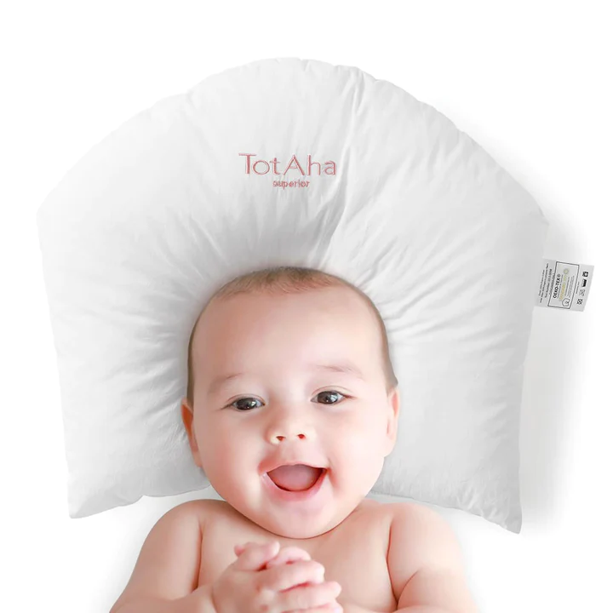
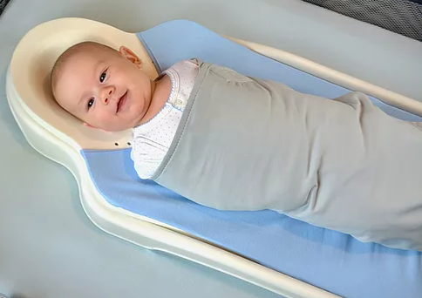
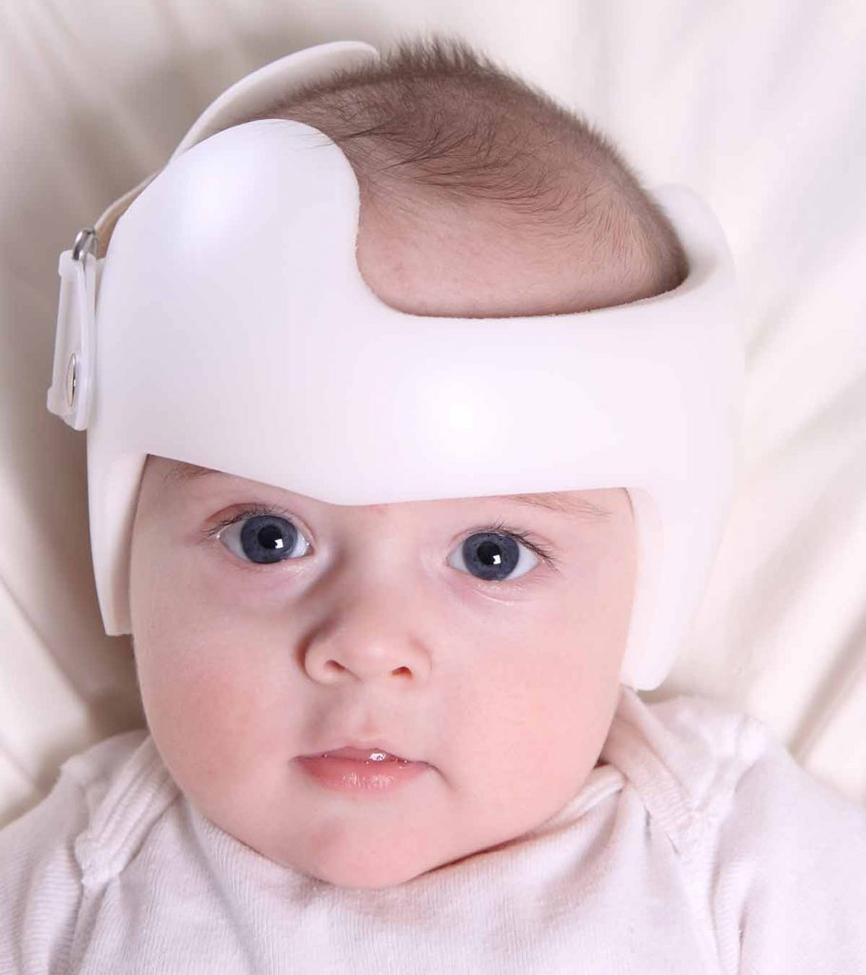
Current Solutions
Pillows
Perfect Noggin
Helmet
Notes:
[TERA]
two devices have the concept of preventing flat head syndrome, however it also has a high possibility in SIDS. [CLICK]Through further research, we have noticed three main devices that are currently on the market for treating positional plagiocephaly. [CLICK]
The cheapest and most simplest device is a basic pillow with an indent in the center for where the head is to be placed. These pillows range from $10 (on Amazon) to $40. However, the FDA does not approve of pillows for infants due to the increased risk of suffocation and sudden infant death syndrome (SIDS). [CLICK]
The second device is the Perfect Noggin, a bassinet that has a head-component similar to the pillow, which retails for $150. These
The last device we have researched is one of the most commonly-known treatments: the cranial helmet, which can cost up to $3000. Although this is currently the most effective treatment for flat head syndrome, there are lots of psychosocial effects that can alter the development of the child when needing to wear this helmet. [CLICK]

Slide 5
02
Project Goal
Notes:
[TERA]
After analyzing the current solutions, we have outlined the goal of our project:

Slide 6
Client Statement
Develop an infant-safe device that periodically rotates an infant’s head while they are asleep without disruption to prevent the development of plagiocephaly (flat head syndrome, FHS). This device will be comfortable and adjustable for the user as well as affordable for the client.
Notes:
[TERA]
That is to … [read slide]
Develop an infant-safe device that periodically rotates an infant’s head while they are asleep without disruption to prevent the development of plagiocephaly (flat head syndrome, FHS). This device will be comfortable and adjustable for the user as well as affordable for the client.

Slide 7
Objectives
Cycle Options
Appropriate
Dimensions
Installation
Safety
Prevention of a Stationary Head
Portable
Automation
Cost
Comfort
Notes:
[TERA]
And to meet our project goal, we have outlined nine objectives that meets our consumer and user needs.
We want to…
Prevent a stationary head
Through automations to possibly relieve stress from the caretaker and ensure that there is consistent movement of the infant head
For the user, we want to…
Make the device safe
Making the device comfortable
Which includes having appropriate dimensions
Lastly, for the consumer and caretakers, we want to…
Make this device low-cost
Easy to install
Portable so it can be used in multiple places
And gives the caretaker the option to select how frequent they want the head to be rotated

Slide 8
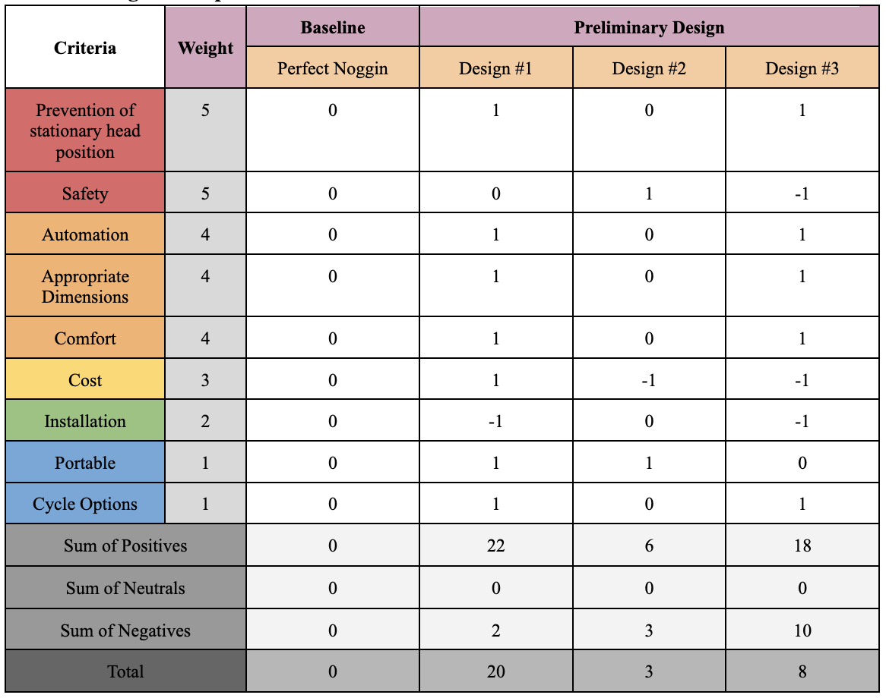
Pugh Concept Analysis
Notes:
[TERA]
We came up with 3 preliminary designs, ranked and weighted our objectives, and compared it to the Perfect Noggin as our baseline design. Through our Pugh Concept Analysis, Design #1 was quantitatively the better device, in which Avi will go into depth about its development.

Slide 9
03
Our Design

Slide 10
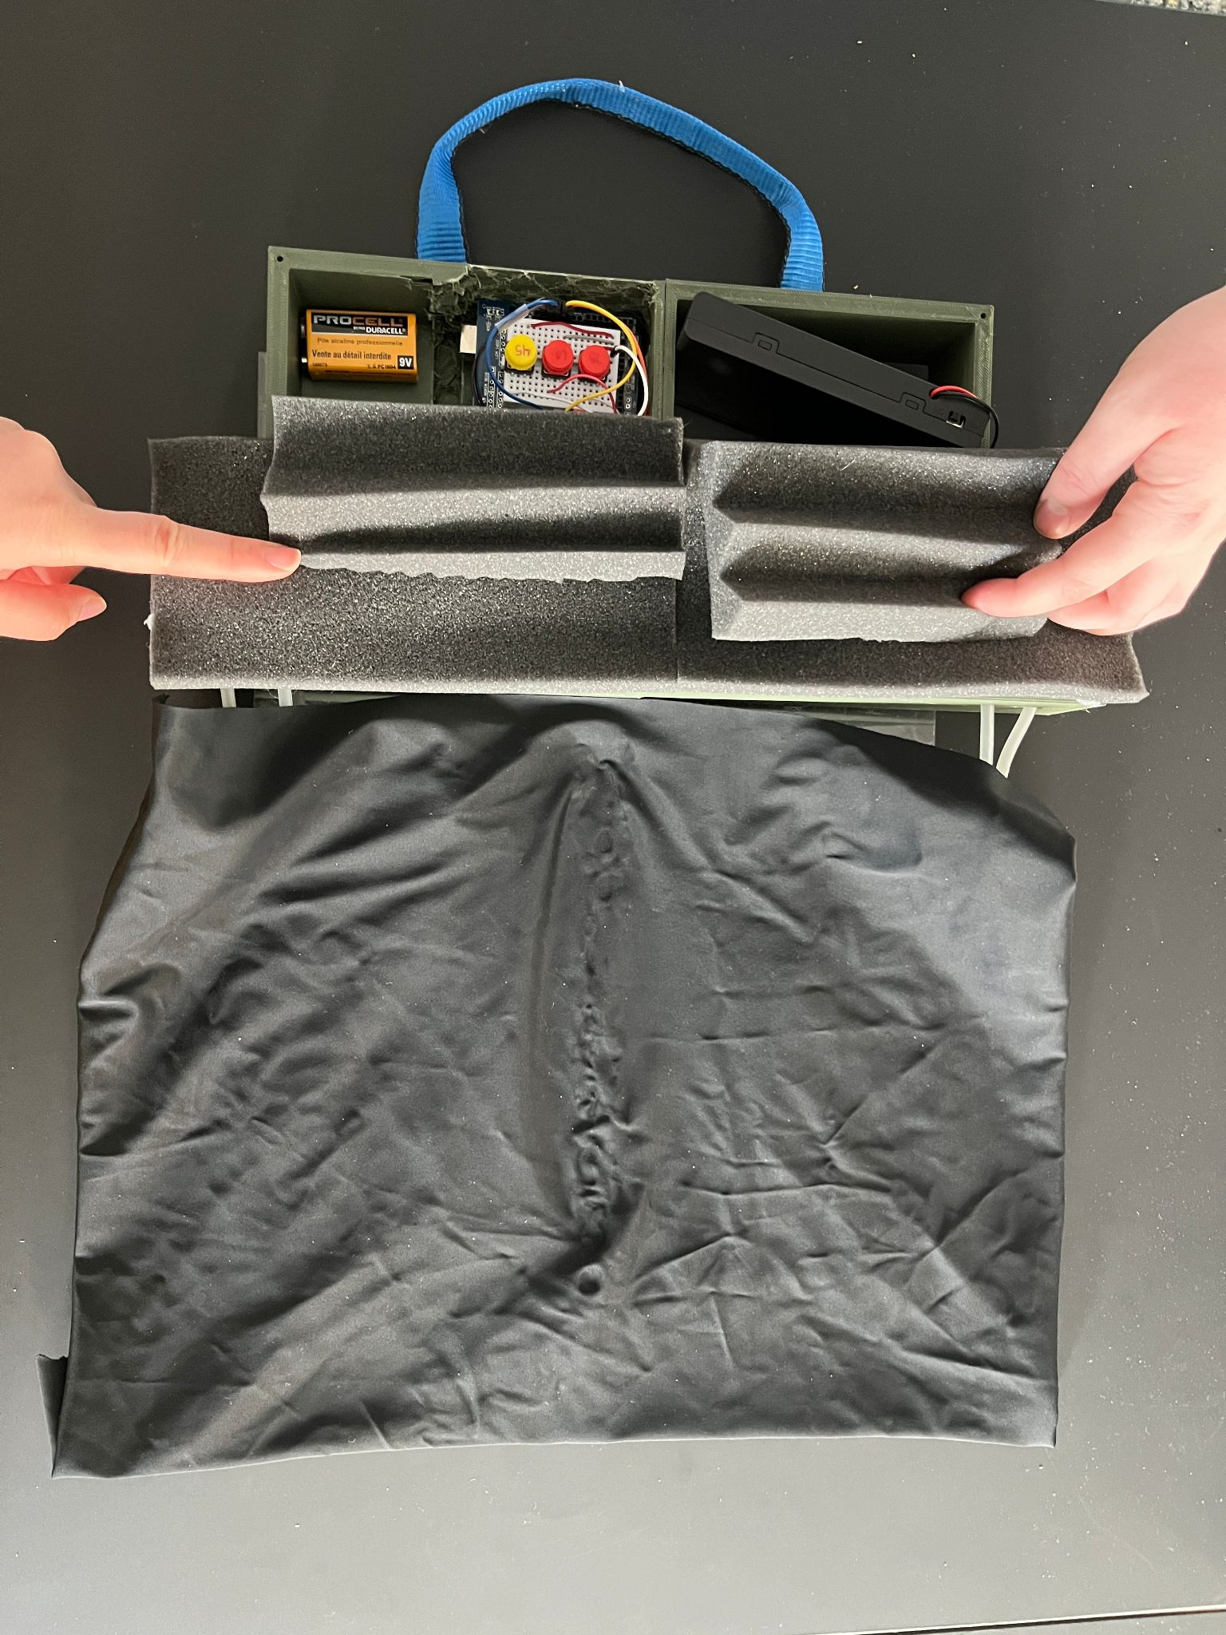
The Teeter-Tot Design
Control Panel
Sound Insulation
Inflatable Pads
Notes:
This picture displays our final prototype design with our baby head model that was used for testing
The head model represents the weight and size of an infant head, we created three different models to account for a range of sizes for each infant
Talk about inflatable pads -> this is the mechanism that will turn the infants head. The pillows will inflate and deflate through two tubes and two DC air pumps periodically. There will be a demonstration later in this presentation
Talk about sound insulation -> used to decrease the decibel level of pump vibration noise
Control Panel -> in depth on next slide

Slide 11
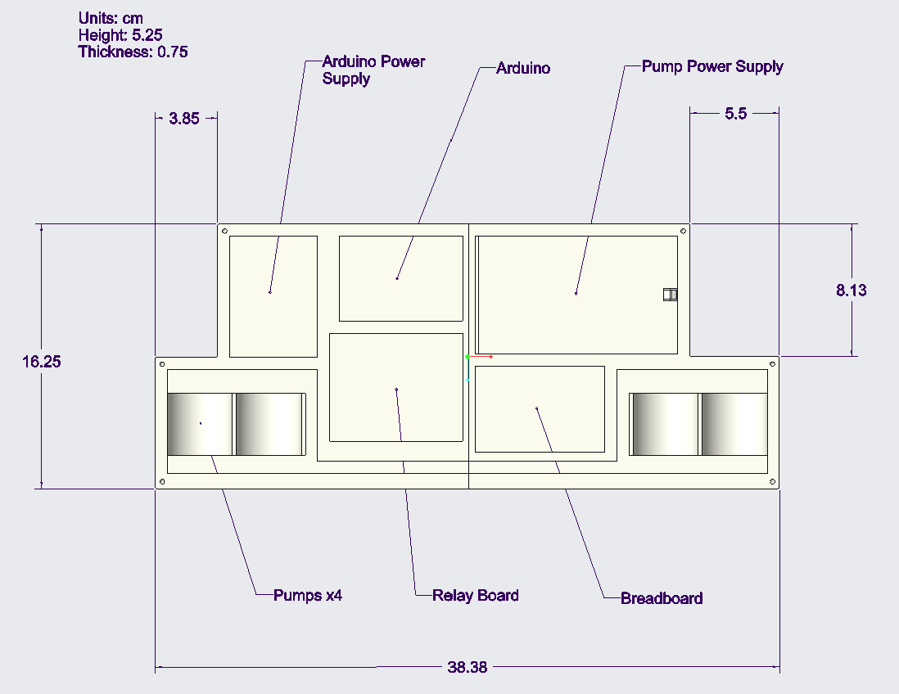
Notes:
This is inside the control panel.
Start talking about arduino power supply, supposed to be 9V battery
Arduino
Relay Board to allow second power supply for pumps
Pump Power supply 12V
Breadboard to connect relay, power supply, and 4.5V DC air pumps
Pumps in the corners

Slide 12
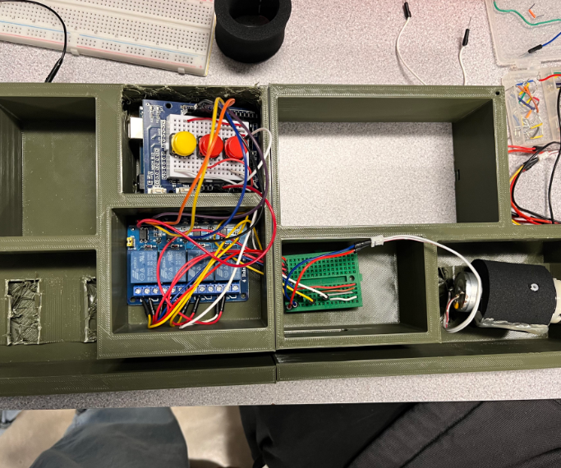

Slide 13
Cost Analysis
Part Name | Purpose | Cost
Inflatable Pad | For the sides of the device | $3.58
Air Pump | To pump air to inflate/deflate the pads | $35.96
Pump Tube | To direct airflow in and out of the pads | $5.00
Sealant | To airtight seal the tubes to the pads | $9.06
Relay Board | For circuit | $7.99
Soundproof Foam | To ensure the pumps are encased in a soundproof material | $2.49
On/Off Switch | To turn on and off the circuit | $5.50
 | TOTAL | $64.08
Notes:
This is our cost analysis, total cost of ~$65.
Some things left out that we didn't have to pay for, but overall affordable product. It is hard to compare it to the production cost of our competitors, but different concept

Slide 14
04
Testing

Slide 15
Tests
PASSED
FAILED
Portability
Glue
User Assembly
Cycle Transition
Size Compatibility
Rotation Angle
Sound
Location Versatility
Power Duration
Notes:
We conducted 9 tests, on this slide passing is indicated by a purple color, and failing by pink. Our device passed 6 out of the 9 tests. [LIST TESTS]; To highlight one test, we tested the rotation angle of the infant heads that our device produced. To test this we used images and tracked a spot on the model heads when deflated and at peak inflation. The rotation of the head varied between 25 and 45 degrees of rotation. Our device passed this test because it rotated the infant heads less than 90 degrees which ensures that the infant’s head will be in a comfortable and safe position while using our device.
—
Glue Test - We tested the different materials we were using with different types of glue to figure out which would be best
Cycle Transition - We timed the transition of inflation and deflation. Our device passed this test by taking longer than 15 seconds to inflate or deflate
Size Compatibility - We created 3 sizes of model infant heads to test with the device, newborn, 6 months, and an average size from 0-6 months. The largest head, that of an avg 6 month old, was the best fit, but the others weren’t bad fits.
Portability - Our device did not fold up like we originally intended for it, but we included a handle to make carrying it easier.
Decibel Test - Only one of the pumps was found to operate under 60 decibels, so this test was failed.
Rotation Angle - The rotation of the head varied between 25 and 45 degrees of rotation. Our device passed this test because it rotated the infant heads less than 90 degrees.
User Assembly - We created a user guide and tested the device setup with 3 subjects. Two rated the ease of use at 2 (easy) out of 5 and the third rated it at 4 (difficult). Our device passed this test because the average was under 3 (neutral) out of 5.
Location Versatility - Our device failed this test because the strap was too short to wrap around a crib-sized table.
Power Duration - We had issues with the 9V battery that was used to power the Arduino, the device did not work after 6 hours so it failed this test.

Slide 16
05
Takeaways
Notes:
Finally, we will discuss the overall results with our device and what next steps can be taken to improve the device even more.

Slide 17
Success
It Works!
Unique
Portable
1
2
3
Notes:
Our device overall was very successful for being our initial prototype. [CLICK]
First off, the proposed concept and execution was successful. Our design is functional and performs what we intended the device to do, which was to automatically and safely rotate an infant's head [CLICK]
Next, our design is a one of a kind. There are no other devices that are similar to this, meaning our device will be marketable and stand out compared to other products that serve the same purpose. [CLICK]
Lastly, our design is portable. The security and strap features allow for the device to be taken anywhere and used on the go.
Despite these successes, our design is not perfect and can be improved upon. [CLICK]

Slide 18
Looking Ahead…
Design
Testing
Future
Applications
1
2
3
Notes:
Design improvements
First, the overall design of the device can be altered to be more compact, quieter, and better fitted for different shaped infant head sizes.
Testing improvements
Second, more testing can be done for the device. Potentially including sensors to improve movement and force precision can improve upon our device function and safety.
Future Applications
Finally, this device can inspire similar devices for other types of health-related issues. Usage for people who are consistently on their backs for health reasons, such as comas, old age, or recovery are potential areas of focus.
First off, the size of the device can be more compact. The final design of the control board itself ended up being significantly larger than anticipated. This was due to to the electrical components and power sources available to us. However, with further prototyping and testing of different, more compact microcontrollers, wiring, and power sources, the overall design can become smaller in size.
Second, the noise level of the device can be reduced. 3 out of the 4 pumps used produced a noise level above 60 db, which resulted in a fail for our test. The device is definitely too loud to be used for sleeping infants currently. By including more secured soundproof features, the relative noise produced by the device can be decreased.
Finally, the shape of the device can be adjusted. Due to the shape of the pillows implemented into the device, the comfort and fit was not suited as well for smaller infant head sizes as well as larger infant head sizes. By using different shaped pillows or modifying the device to have an adjustable feature for the pillows, the device can be better suited for smaller infants.

Slide 19
Thank you!
Group 2 | Teeter-Tot
BME 3300 C2023
______________________________________________________
Jim Doucette - 3D Printing and CAD Design
Avi Bissoondial - Arduino Programming
Gray Hauff - Device Assembly
Tera Keang - Device Assembly
Please keep this slide for attribution

